Slide 1
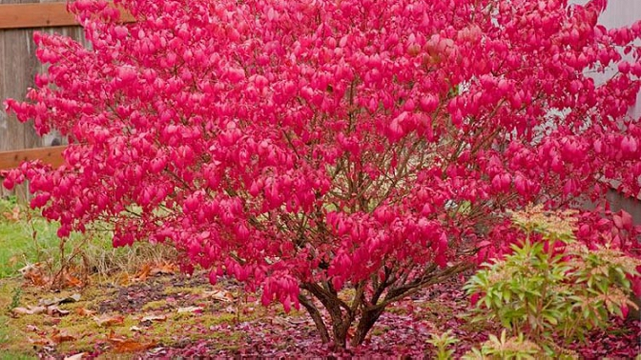
The Burning Bush
Exodus 3:1-10
Notes:
Can you identify the plant on the screen?
I know that we have some amateur botanists in our number (avid gardeners)
It’s scientific name is euonymus alata – Commonly called the Burning bush
The reasons are obvious, the name is taken from the text of Exodus 3, where a literal and much more impressive burning bush is found
(Exodus 3:1-10), “Now Moses was tending the flock of Jethro his father-in-law, the priest of Midian. And he led the flock to the back of the desert, and came to Horeb, the mountain of God. ² And the Angel of the Lord appeared to him in a flame of fire from the midst of a bush. So he looked, and behold, the bush was burning with fire, but the bush was not consumed. ³ Then Moses said, “I will now turn aside and see this great sight, why the bush does not burn.” ⁴ So when the Lord saw that he turned aside to look, God called to him from the midst of the bush and said, “Moses, Moses!” And he said, “Here I am.” ⁵ Then He said, “Do not draw near this place. Take your sandals off your feet, for the place where you stand is holy ground.” ⁶ Moreover He said, “I am the God of your father—the God of Abraham, the God of Isaac, and the God of Jacob.” And Moses hid his face, for he was afraid to look upon God. ⁷ And the Lord said: “I have surely seen the oppression of My people who are in Egypt, and have heard their cry because of their taskmasters, for I know their sorrows. ⁸ So I have come down to deliver them out of the hand of the Egyptians, and to bring them up from that land to a good and large land, to a land flowing with milk and honey, to the place of the Canaanites and the Hittites and the Amorites and the Perizzites and the Hivites and the Jebusites. ⁹ Now therefore, behold, the cry of the children of Israel has come to Me, and I have also seen the oppression with which the Egyptians oppress them. ¹⁰ Come now, therefore, and I will send you to Pharaoh that you may bring My people, the children of Israel, out of Egypt.”
Notice in verse 3, Moses called it a “great sight”
It must have been amazing to see a bush burning, but not being consumed
And yet, the site became even more amazing, as the Lord spoke from the midst of the bush
The bush got Moses’ attention. Let’s turn our attention to the burning bush, and consider a few lessons we can learn from its appearance to Moses
Based on the article, The Burning Bush – by Joe R. Price
-Edited reprint, The Spirit’s Sword, July 12, 2009

Slide 2
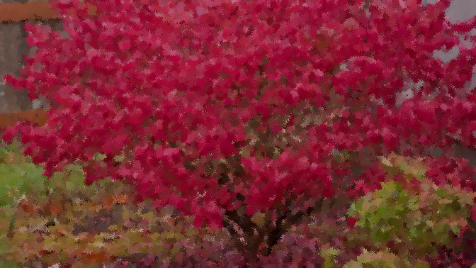
The Burning Bush…
Reminds us of the presence of God
  (3:4) Genesis 28:12-13, 16-17; Hebrews 1:1-2
Reminds us of the holiness of God
  (3:5) 1 Corinthians 6:17-7:1; 1 Peter 1:15-16
Reminds us that Scripture is God’s word
  (3:6) Matthew 22:31-32; Luke 6:46-49
Reminds us of the deliverance of God
(3:7-10) Romans 6:17-18; 6:3-4
Notes:
The burning bush reminds us of the presence of God.
God was present as He spoke to Moses from the midst of the bush
(Exodus 3:4), “So when the Lord saw that he turned aside to look, God called to him from the midst of the bush and said, “Moses, Moses!” And he said, “Here I am.”
God could have made His presence known another way, but he used a burning bush on that occasion.
He had previously made His presence known through visions and dreams
(Genesis 28:12-13, 16-17), [Jacob’s dream at Bethel], “Then he dreamed, and behold, a ladder was set up on the earth, and its top reached to heaven; and there the angels of God were ascending and descending on it. ¹³ And behold, the Lord stood above it and said: “I am the Lord God of Abraham your father and the God of Isaac; the land on which you lie I will give to you and your descendants… (16-17), “Then Jacob awoke from his sleep and said, “Surely the Lord is in this place, and I did not know it.” ¹⁷ And he was afraid and said, “How awesome is this place! This is none other than the house of God, and this is the gate of heaven!”
Even as God’s word announced His presence to Moses, His inspired word announces His presence to us today
(Hebrews 1:1-2), “God, who at various times and in various ways spoke in time past to the fathers by the prophets, ² has in these last days spoken to us by His Son, whom He has appointed heir of all things, through whom also He made the worlds.”
God is everywhere, seeing and knowing all things
Jonah, (for example), learned it is impossible to flee from God’s presence and His will (cf. Jonah 1).
Do not run from God’s presence; run to Him and abide with Him in Christ
(Matthew 11:28-30), “Come to Me, all you who labor and are heavy laden, and I will give you rest. ²⁹ Take My yoke upon you and learn from Me, for I am gentle and lowly in heart, and you will find rest for your souls. ³⁰ For My yoke is easy and My burden is light.”
[CLICK] The burning reminds us of the holiness of God.
Because God is holy, when we approach Him, it must be in holiness
Symbolized by the removal of shoes
(Exodus 3:5), “Then He said, “Do not draw near this place. Take your sandals off your feet, for the place where you stand is holy ground.”
Christians stand on holy ground, communing with God. Consider God’s call
(2 Corinthians 6:17-7:1), “Therefore, ‘Come out from among them and be separate, says the Lord. Do not touch what is unclean, and I will receive you.” ¹⁸ “I will be a Father to you, and you shall be My sons and daughters, says the Lord Almighty.’ (Chapter 7), ​¹ Therefore, having these promises, beloved, let us cleanse ourselves from all filthiness of the flesh and spirit, perfecting holiness in the fear of God.”
We must be holy “in all our conduct” because God is holy
(1 Peter 1:15-16), “but as He who called you is holy, you also be holy in all your conduct, ¹⁶ because it is written, “Be holy, for I am holy.”
We cannot live in the presence of God if we are living in sin.
[CLICK] The burning bush reminds us that Scripture is the word of God.
Concerning God’s message to Moses from the burning bush, Note what Jesus said in Matthew 22, about Exodus 3:6
(Matthew 22:31-32), [Arguing the resurrection with the Sadducees], “But concerning the resurrection of the dead, have you not read what was spoken to you by God, saying, ³² “I am the God of Abraham, the God of Isaac, and the God of Jacob’ ? God is not the God of the dead, but of the living.”
Those Sadducees did not “know the Scriptures” and, as a result, twisted them to suit their false teaching of no resurrection
We must get this point: Jesus said God is speaking to you when you read the Scriptures.
One cannot successfully claim faith in Jesus while rejecting what the Scriptures say.
To deny and reject the Scriptures is to deny and reject the very word spoken to us by God.
We will not succeed resisting God’s word.
We must submit and obey God in faith
(Luke 6:46-49), “But why do you call Me ‘Lord, Lord,’ and not do the things which I say? ⁴⁷ Whoever comes to Me, and hears My sayings and does them, I will show you whom he is like: ⁴⁸ He is like a man building a house, who dug deep and laid the foundation on the rock. And when the flood arose, the stream beat vehemently against that house, and could not shake it, for it was founded on the rock. ⁴⁹ But he who heard and did nothing is like a man who built a house on the earth without a foundation, against which the stream beat vehemently; and immediately it fell. And the ruin of that house was great.”
[CLICK] The burning bush reminds us of the deliverance of God.
God was about to free His people from their bondage
(3:7-10), “And the Lord said: “I have surely seen the oppression of My people who are in Egypt, and have heard their cry because of their taskmasters, for I know their sorrows. ⁸ So I have come down to deliver them out of the hand of the Egyptians, and to bring them up from that land to a good and large land, to a land flowing with milk and honey, to the place of the Canaanites and the Hittites and the Amorites and the Perizzites and the Hivites and the Jebusites. ⁹ Now therefore, behold, the cry of the children of Israel has come to Me, and I have also seen the oppression with which the Egyptians oppress them. ¹⁰ Come now, therefore, and I will send you to Pharaoh that you may bring My people, the children of Israel, out of Egypt.”
Israel’s deliverance foreshadowed God’s salvation of sinners from sin’s bondage by the blood of Christ.
Sinners are “freed from sin” when they “obey from the heart” the gospel
(Romans 6:17-18), “But God be thanked that though you were slaves of sin, yet you obeyed from the heart that form of doctrine to which you were delivered. ¹⁸ And having been set free from sin, you became slaves of righteousness.”
Obedience from the heart is the occasion when God will “see the blood” (Like the Passover) and forgive sins by the death of Jesus
(Romans 6:3-4), “Or do you not know that as many of us as were baptized into Christ Jesus were baptized into His death? ⁴ Therefore we were buried with Him through baptism into death, that just as Christ was raised from the dead by the glory of the Father, even so we also should walk in newness of life.”

Slide 3
Conclusion
The burning bush teaches us lessons of truth and holiness!
May we remove every defilement of sin and obey God!
Ephesians 4:21-24
Notes:
The burning bush teaches us lessons of truth and holiness!
May we remove every defilement of sin and obey God
(Ephesians 4:21-24), “if indeed you have heard Him and have been taught by Him, as the truth is in Jesus: ²² that you put off, concerning your former conduct, the old man which grows corrupt according to the deceitful lusts, ²³ and be renewed in the spirit of your mind, ²⁴ and that you put on the new man which was created according to God, in true righteousness and holiness.”

